Slide 1
Introduction to single-cell RNA-seq analysis (Day 1)
Jeremy M. Simon, Ph.D.
Assistant Professor, Department of Genetics
Director, UNC Neuroscience Center Bioinformatics Core
Co-Principal, Bioinformatics and Analytics Research Collaborative (BARC)

Slide 2
Outline for my section
Day 1
Rationale: Why do single-cell RNA-seq?
Overview of experimental methodologies/platforms
Best practices for experimental design
Overview of data processing tools
Workshop: Begin analysis of scRNA-seq data from E18 mouse cortex
Day 2
Workshop: Continue analysis of scRNA-seq data from E18 mouse cortex
Overview of cell type annotation
Overview of data handling with multiple conditions and differential expression
Overview of pseudotiming
Brief discussion of other scRNA-adjacent approaches to be aware of
List of other available resources

Slide 3
Why single-cell RNA-seq?
Complex tissues contain lots of diverse cell types at different proportions
Profiling gene expression of tissue in bulk provides essentially a population-wide average, which can vary based on cellular composition
 | Green | Blue | Yellow | Red | TISSUE
GeneA | 10 | 5 | 15 | 50 | 20
GeneB | 2 | 50 | 20 | 0 | 18
GeneC | 3 | 3 | 3 | 3 | 3
GeneD | 50 | 0 | 40 | 10 | 25
GeneE | 0 | 10 | 40 | 10 | 15

Slide 4
Why single-cell RNA-seq?
WT
Mutant
Scenario 1:
Altered proportions
In either scenario, bulk RNA-seq would likely have insufficient power to detect these differences
WT
Mutant
Scenario 2:
Altered expression
in subset of cells
Cell type A
Cell type B
Cell type C
Cell type D
Cell type D’

Slide 5
Why single-cell RNA-seq?
WT
Mutant
Scenario 1
Mutant
Scenario 2
Bulk
Traditional
solution:
FACS-sorted
Green | 7
Blue | 7
Yellow | 5
Red | 5
Green | 7
Blue | 7
Yellow | 3*
Red | 8*
Green | 7
Blue | 7
Yellow | 5
Red | 5

Slide 6
Why single-cell RNA-seq?
FACS sorting can detect proportional shifts in cell types, provided enough cells and strong selective markers
Sorting is unlikely to detect effects in subsets of cell types, and may still be underpowered even if followed by RNA-seq.
For complex tissues, all of this is cost-prohibitive, and often the effect is unknown

Slide 7
Single-cell RNA-seq using 10X
Co-capture individual cells with barcoded beads
Typically 3’ based with oligo-dT amplification, but 5’ also an option
After sequencing, deconvolute which detected transcripts came from which cells
One “inlet” of 10X lane can only process ~10k cells, and by default only 1 experimental condition at a time
More on this later

Slide 8
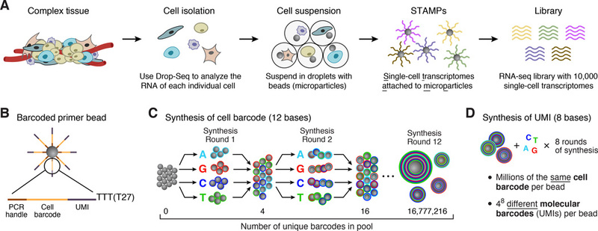
How does it work?
Prepare tagged beads (this is done commercially)
Prepare single-cell solution (this is done by you)

Slide 9
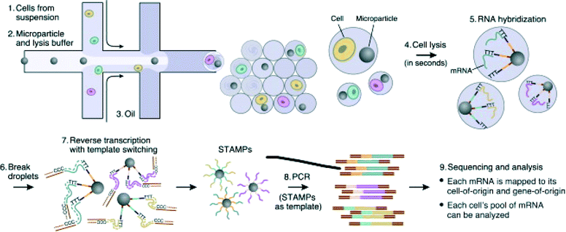
How does it work?
*
*Typically, we prepare our mouse suspensions with a 2.5-5% spike-in of HEK cells and analyze mouse+human reads to estimate cell doublet rate

Slide 10
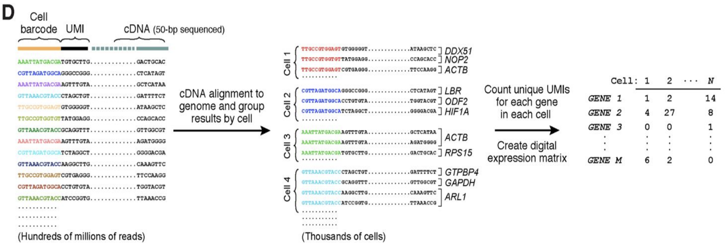
How does it work?

Slide 11
Brief overview of data processing
Deconvolute cell/molecular barcodes
Trim 5’ primer sequence
Trim 3’ polyA sequence
Alignment
Determine which reads came from which transcripts
Construct cells x genes data matrix
R1.fastq
R2.fastq
@K00270:34:HGWWGBBXX:1:1101:1641:1279 1:N:0:NGAGCTAC
TGAACGTAGGCGGGGAAGAG
+
AAAFFJJJJJJJJJJJJFJJ
@K00270:34:HGWWGBBXX:1:1101:1945:1279 1:N:0:NGAGCTAC
GGTACATGTAGTATACCTTT
+
AAFFFJJJJJJJJJJJJJJJ
@K00270:34:HGWWGBBXX:1:1101:29437:1894 2:N:0:GGAGCTAC
GAAGAATCCGAGGAGTCTGATGATGACATGGGCTTTGATCTATTTGAATA
+
A<<AAJ<A7FF<7-7-7-7F--JA-JAJ<-7-7-7----<------7--<
@K00270:34:HGWWGBBXX:1:1101:29680:1894 2:N:0:GAAGCTAC
ATGCTATTCATGTCTTTATACAACTAAAGCTGATCTGACTGAGCATGTCA
+
-<-7-77A<--<A----<<7FF<A-7F<-<A-FJAFAFA---F<A----<
CellRanger (10X) performs these steps for you

Slide 12
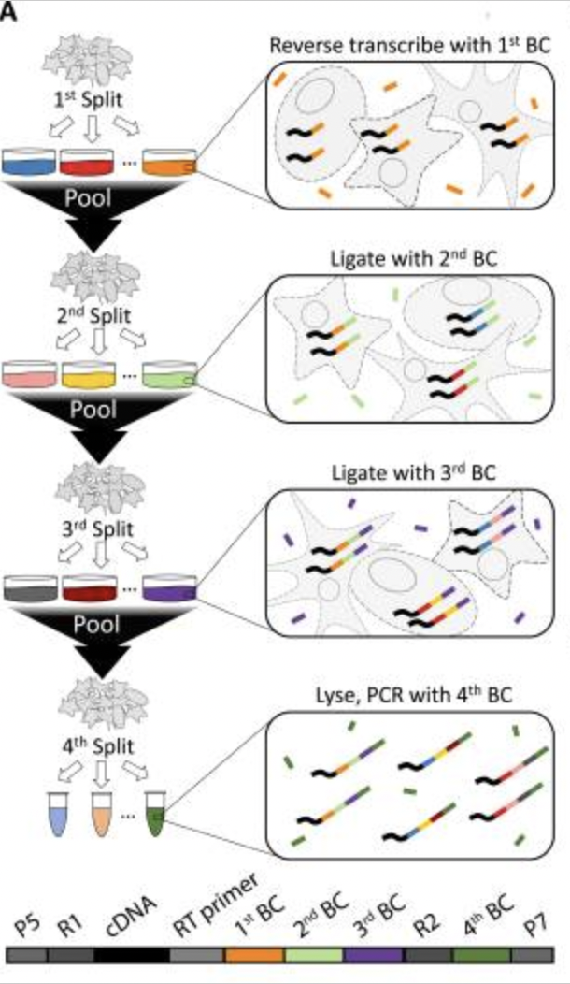
Single-cell RNA-seq using combinatorial indexing (e.g. SPLiT-seq, ParseBio)
First barcode is added via oligo-dT or random hexamer priming
2nd and 3rd barcodes are added sequentially after a pooling and splitting of cells
4th barcode is compatible with Illumina sample multiplexing
Each of these corresponds to one “sublibrary”, ie a unique collection of BC1-BC2-BC3 combinations
Watch movie here to understand better:
https://www.youtube.com/watch?v=WqaeZe7mKUc
Rosenberg, et al, Science, 2018

Slide 13
Benefits to combinatorial indexing
Can process hundreds of thousands or even millions of cells simultaneously from multiple conditions
No special equipment needed
Cheap per cell and scalable
Minimal batch effects
Compatible with both fresh and fixed cells or nuclei

Slide 14
Brief overview of data processing
Merge oligo-dT and random hexamer versions of the same cell
CTGTAGCC-ACACAGAA-AACGTGAT CTGTAGCC-ACACAGAA-GATAGACA denote the same cell primed two ways
Determine how many viable “cells” got sequenced (remove debris)
Determine which reads came from which transcripts
Construct cells x genes data matrix
Deconvolute sample-level barcodes to separate multiplexed experimental conditions
R1.fastq
(cDNA)
R2.fastq
(UMI, barcodes)
See here for one solution:
https://combine-lab.github.io/alevin-fry-tutorials/2022/split-seq/

Slide 15
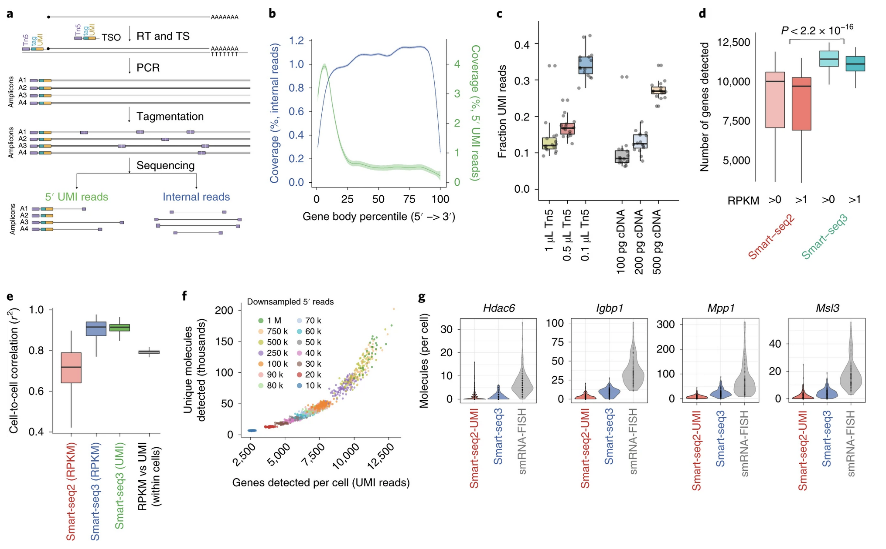
Single-cell RNA-seq with full-length transcripts using Smart-seq
https://doi.org/10.1038/s41587-020-0497-0

Slide 16
Best practices for experimental design
Replicates, replicates, replicates!
Some argue that since each cell is a replicate of the next, you don’t need true biological replicates
e.g. multiple human tissue samples, multiple mice, multiple cell culture plates, etc
Variability in expression, and especially in cell proportions assigned to each cell type, is unfortunately quite large
I am currently recommending labs do >3 replicates per condition to capture and account for this variability
Each replicate should have several thousand cells sequenced at >50k reads/cell, I recommend >10k cells per condition

Slide 17
Best practices for experimental design
Control for batch effects!
10X can only isolate one sample at a time
This means separate isolations for different experimental conditions- a major confounder in doing any statistics
New “Cell Hashing” approaches allow for multiplexing, but may not work for certain cell types (especially in neuro) as it is antibody/lipid mediated, and costs extra
Try to at least get WT_rep1 and MUT_rep1 captured with 10X on the same day if multiplexing is not possible
Other non-10X solutions (e.g. SPLiT-seq/ParseBio) may be more appropriate for complex experimental setups with multiple conditions, or tissues where Cell Hashing less effective

Slide 18
Best practices for experimental design
Other considerations
Unknown whether cell size plays a role in isolation. Do larger cells get stuck in microfluidics channels and not get discovered? You only get what you get…
Data are very sparse, lots of 0s. Essentially probing expression of only top 10-20% expressed genes
If lab is interested in genes known to be lowly expressed (many transcription factors are!), scRNA-seq may not be appropriate
Can sequence whole cells or just nuclei
This is especially relevant for cell type annotation, ie cell surface receptors won’t be detectable in snRNA-seq data

Slide 19
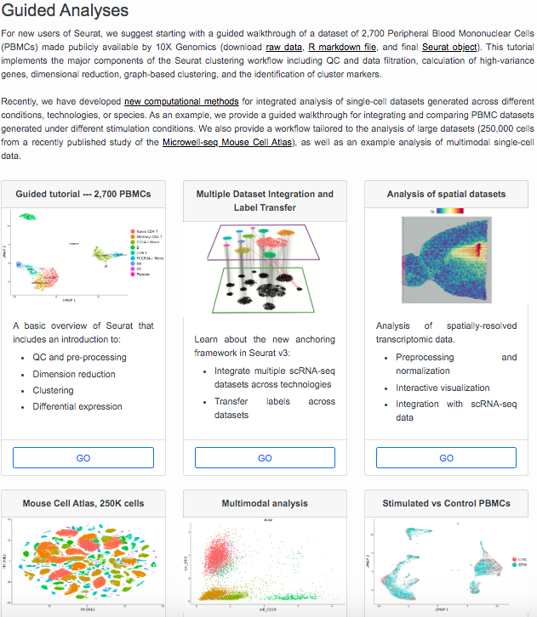
Seurat streamlines data analysis
Helpful vignettes
Reads in data in multiple formats, including CellRanger output
Enables analysis and exploration of single-cell data
https://satijalab.org/seurat/
https://github.com/satijalab/seurat

Slide 20
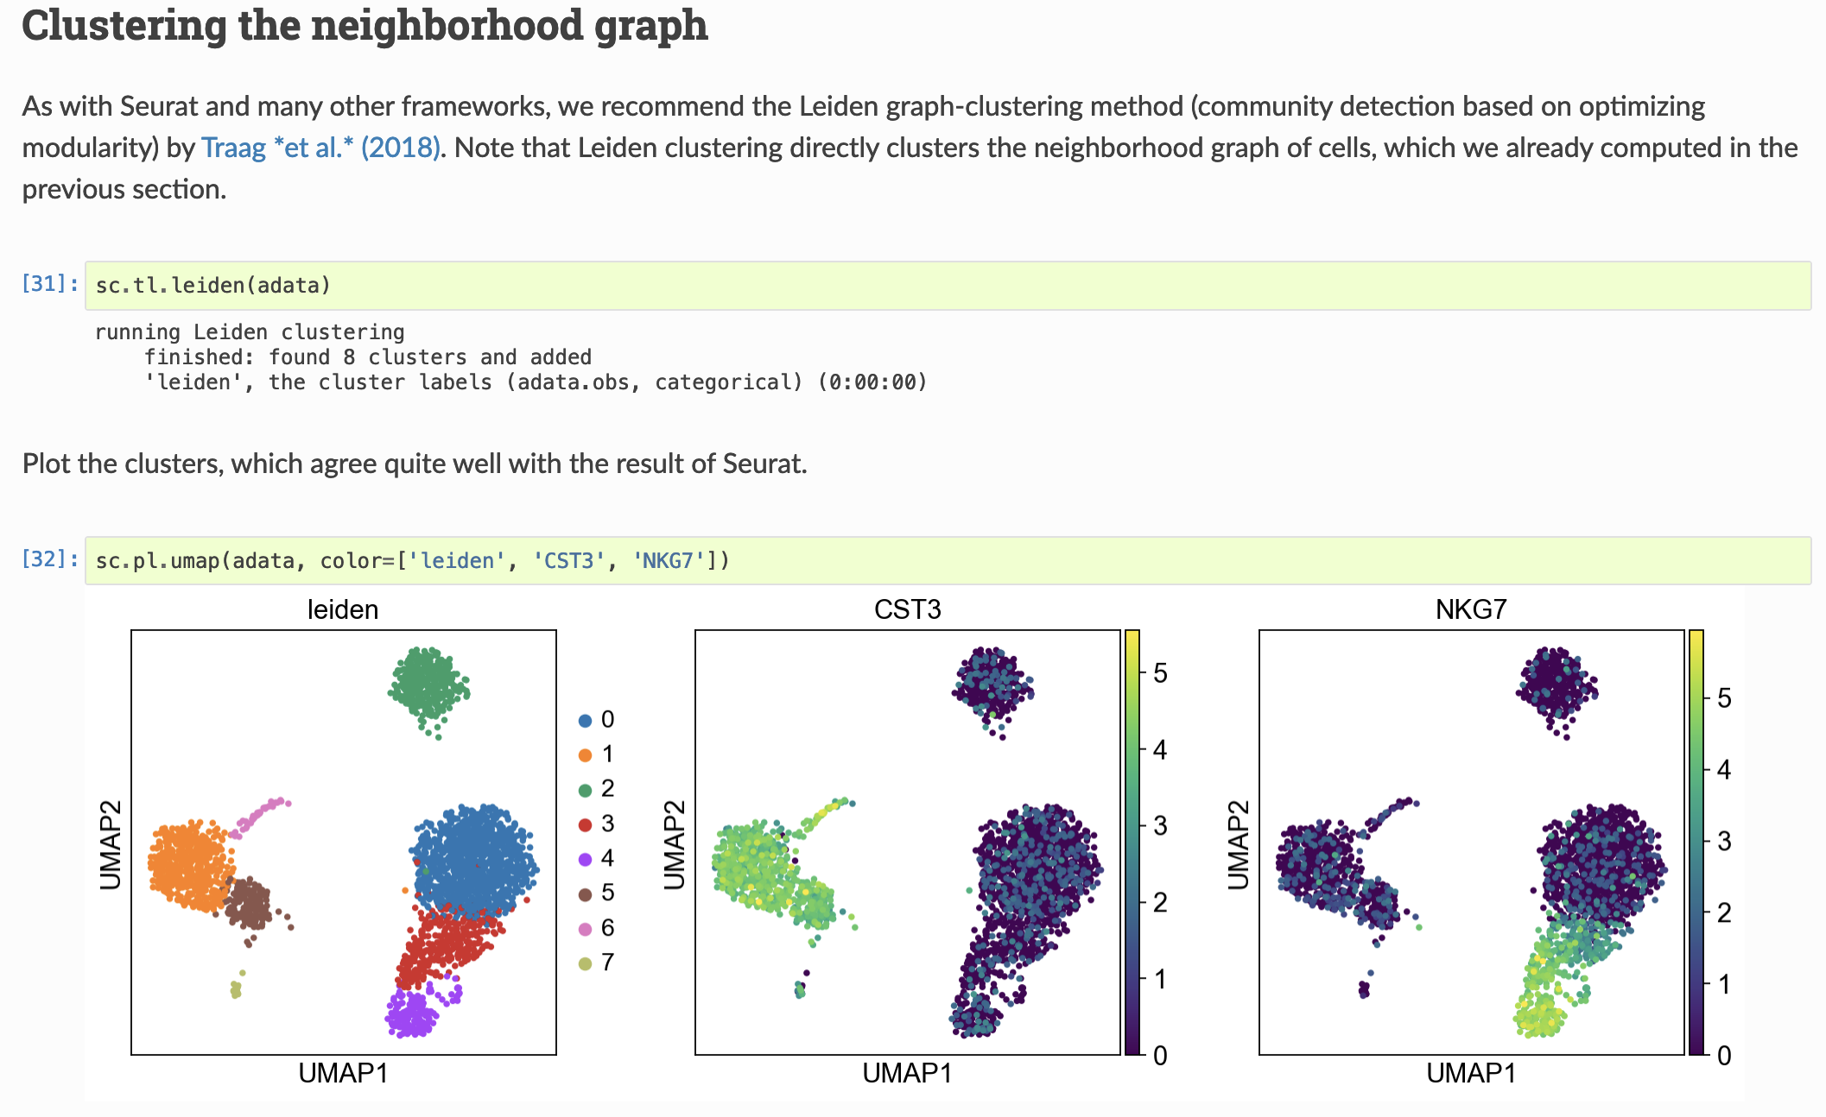
scanpy is a similar framework in Python
Helpful tutorials
Reads in data in multiple formats, including CellRanger output
Enables analysis and exploration of single-cell data
https://scanpy.readthedocs.io/en/stable/
https://github.com/theislab/scanpy

Slide 21
Alevin/alevin-fry: Open-source alternative to CellRanger
My current preference for single-cell data processing
Written and supported by Rob Patro’s lab
Same group that wrote Salmon for bulk RNA-seq transcript quantification (alevin is within the salmon ecosystem)
With contributions by UNC’s Mike Love
Can handle data from 10X, SPLiT-seq/ParseBio, and others
Can also process spatial transcriptomic data (e.g. 10X Visium)
Alevin-fry will eventually replace alevin completely
https://alevin-fry.readthedocs.io/en/latest/
https://combine-lab.github.io/alevin-fry-tutorials/#blog
https://github.com/COMBINE-lab/salmon/

